Slide 1
NEXUS
TEAM NEXUS · MAJOR PROJECT · ADVANCED JAVA (PBL)
A-101
A-102
A-103
FULL
AVAILABLE
FULL
A-104
B-201
B-202
AVAILABLE
FULL
MAINTENANCE
Smart PG & Hostel Management System
B-203
B-204
C-301
AVAILABLE
FULL
AVAILABLE
One secure platform for wardens, students, accountants and maintenance staff.
C-302
C-303
C-304
FULL
AVAILABLE
FULL
Arya College of Engineering & I.T., Jaipur
Full
Available
Under maintenance
B.Tech AI & Data Science · Session 2026-27 · Mentor: Er. Ram Babu Buri
Notes:
Introduce Team Nexus and the project. The room tiles on the right are the same three room statuses our system uses: AVAILABLE, FULL and MAINTENANCE - the whole app is about managing exactly this.

Slide 2
Meet Team Nexus
LOBBY · THE TEAM
Guided by Er. Ram Babu Buri (Assistant Professor) · HOD: Dr. Ashok Kumar Kajla
DS
Dhruvraj Shekhawat
Team Leader & Backend Lead
Authentication, Spring Boot architecture, backend integration
24EARAD045
DP
Divyansh Paliwal
Frontend, Security & Documentation Lead
Bootstrap 5 UI, sessions, validation, dashboards, report and PPT
24EARAD047
DK
Divyanshu Kumar
Finance & Reporting Developer
Fees, payments, financial logic, reports
24EARAD048
GS
Garvit Sharma
Database & Room Management Developer
MySQL, JPA / Hibernate, rooms, allocation
24EARAD050
HS
Harsh Sharma
Student & Complaint Module Developer
Students, complaints, visitors, leave
24EARAD057
Notes:
Five members, each owned one primary module and also took part in integration, testing and documentation. Every member can explain both their own module and the full architecture.

Slide 3



Hostels Run on Paper
FLOOR 1 · THE PROBLEM
TODAY
WITH NEXUS
Duplicate data entry
One record, one source of truth
No live room availability
Live bed occupancy on every dashboard
Delayed fee collection
Invoices, part-payments, live status
Untracked complaints
Auto-routed tickets with SLA timers
Uncontrolled visitor entry
Pre-registered passes, warden approval
No approval history
Audit log of who approved what
Notes:
Manual hostel administration: paper registers, spreadsheets and verbal communication. These six pains are exactly what the problem statement in our report lists; each one maps to a NEXUS feature on the right.

Slide 4






What We Set Out to Build
FLOOR 1 · OBJECTIVES
Secure by role
No double booking
Automated fees
Four roles guarded by Spring Security + BCrypt
Digital room, bed and allocation records
Invoices, payments, Pending to Paid status
Accountable repairs
Digital gate passes
Live in the cloud
Auto-routing, SLA deadlines, warden check
Leave and visitor approval with check-in/out
Docker on Render with Aiven MySQL
Out of scope for now: biometric attendance, IoT smart locks, real payment-gateway integration.
Notes:
Six headline objectives from the report. Scope covers one or more hostel blocks under a single administration. Biometrics, IoT locks and a real payment gateway are listed as future enhancements, not part of this version.

Slide 5




Four Roles, One Platform
FLOOR 1 · WHO USES IT
Warden
Student
Accountant
Maintenance
/warden
/student
/accountant
/complaint-staff
Registers students, rooms
Approves allocations, passes
Verifies finished repairs
Views room and fee dues
Pays fees, lodges complaints
Requests leave, visitors
Generates monthly invoices
Records counter payments
Views collection reports
Gets tickets automatically
Accepts and fixes issues
Submits resolution notes
Notes:
Role-based access is the backbone. After login a success handler redirects each role to its own dashboard, and every URL group is protected - a student opening a warden URL gets the Access Denied page.

Slide 6
Technology Stack
FLOOR 2 · TECH STACK
PRESENTATION
Thymeleaf
Bootstrap 5
55 views
Dark mode
WEB & SECURITY
Spring MVC
Spring Security 6
JWT for REST
BUSINESS
Spring Boot 3.3.4
Java 17
Validation
OpenPDF
PERSISTENCE
Spring Data JPA
Hibernate 6
MySQL 8
DELIVERY
Maven
Docker
Render
GitHub
Postman
Notes:
Fully open-source Java stack. Java 17 is the LTS baseline for Spring Boot 3. Server-rendered Thymeleaf pages for the web UI, plus a JWT-secured REST API under /api/ that an optional React client can consume.

Slide 7





Layered Architecture
FLOOR 2 · ARCHITECTURE
Browser
Security
Controller
Service
Repository
MySQL 8
HTML5, Bootstrap 5
Login, BCrypt, role filter
Web pages + /api
Rules, @Transactional
14 Spring Data JPA
14 tables, SSL
Security first
Rules live in services
Two front doors
Every request passes the Spring Security filter chain before any controller runs.
Allocation, fees and complaints run inside @Transactional methods.
55 Thymeleaf pages for people, a JWT-secured REST API for apps.
Notes:
A request goes Browser, Spring Security, Controller, Service, Repository, JPA/Hibernate and then MySQL. The response is rendered by Thymeleaf and returned. Controllers stay thin - business rules and transactions belong to the service layer.

Slide 8
Smart Room Allocation
FLOOR 3 · ROOM ALLOCATION
1
2
3
4
5
Request
Approve
Three guards
Commit
Vacate later
Student asks for a room. Saved as PENDING
Warden reviews it, picks a bed number
No ACTIVE allocation yet
occupied +1, room AVAILABLE or FULL, allocation ACTIVE
occupied -1, status VACATED, history kept
Room not in maintenance
A free bed exists
One @Transactional method: if any step fails, everything rolls back.
Notes:
Walk through the flowchart in the report. On approval the service checks that the student has no ACTIVE allocation, the room is not under maintenance and a bed is free. Then it increments the occupied count, updates the room status, stores the bed number and marks the allocation ACTIVE. Vacating decrements the count and keeps history.

Slide 9
Complaint Lifecycle
FLOOR 3 · COMPLAINTS
SUBMITTED
IN PROGRESS
RESOLVED
VERIFIED
CLOSED
Student lodges
Staff accepts
Staff adds remarks
Warden inspects
Student feedback
Not satisfied? Warden RETURNS it, back to IN PROGRESS
SLA deadline is set automatically from the complaint priority
4
hours to resolve
8
hours to resolve
24
hours to resolve
48
hours to resolve
Notes:
Complaint status flow: SUBMITTED, IN_PROGRESS, RESOLVED_BY_MAINTENANCE, VERIFIED or RETURNED, then CLOSED after student feedback. Complaints are routed automatically to the Maintenance department with an SLA deadline of 4, 8, 24 or 48 hours depending on priority - in our test, a high-priority ticket received an 8 hour SLA.

Slide 10






Built to Be Trusted
FLOOR 3 · TRUST
BCrypt passwords
Role rules on every URL
Never stored in plain text; 60-minute sessions
A student on a warden URL gets Access Denied
Ownership checks
Transactions
Students can pay only their own invoices
Failed allocations or payments roll back
Exact money
Audit trail
BigDecimal and unique constraints, no duplicates
audit_logs and notifications for key actions
Notes:
Security behaviour observed in testing: no role could open another role's pages. Passwords are BCrypt hashes, sessions expire after 60 minutes, ownership checks stop cross-student payments, and money uses BigDecimal. The REST API uses HMAC-SHA256 signed JWT tokens valid for 24 hours.

Slide 11
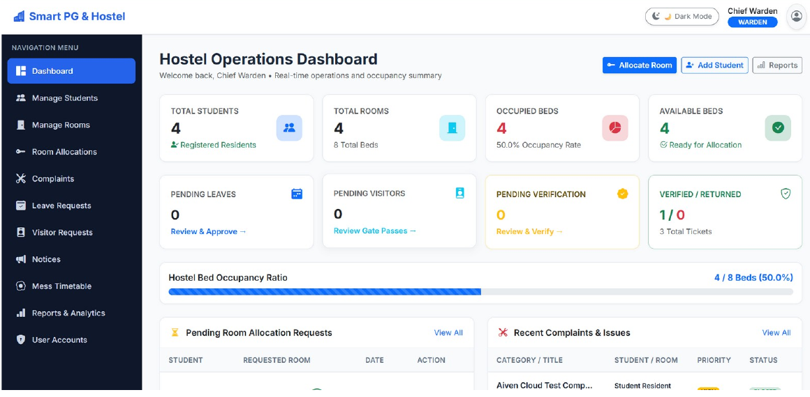
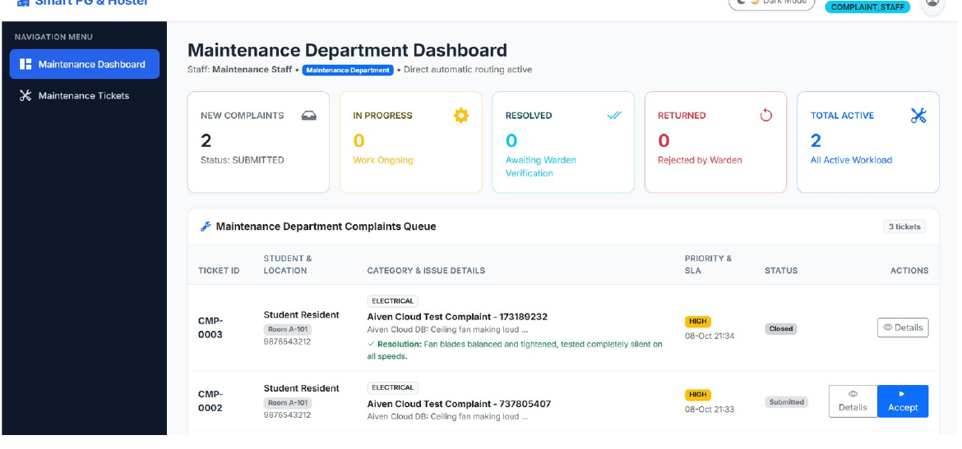
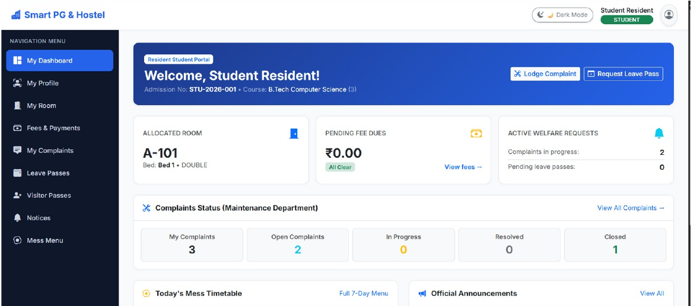
See It Running
FLOOR 4 · LIVE PRODUCT
WARDEN
MAINTENANCE
STUDENT
Real screens from the deployed app: live counts, one-click actions
Notes:
These are real screenshots from the deployed application, taken from Chapter 8 of the report. Warden dashboard: 4 of 8 beds occupied (50 percent). Maintenance queue: tickets arrive automatically with an Accept button. Student portal: room A-101, Bed 1, fee dues clear, complaint summary and mess timetable.

Slide 12
24 Tests, 24 Passes
FLOOR 4 · TESTING
100%
pass rate on the deployed app and locally, for all four roles
Wrong password: no session
Student on warden URL: denied
Over-payment: rejected
Bad URL: custom 404
Notes:
Table 8.5 in the report lists 24 test scenarios across login, security, rooms, students, allocation, fees, payments, complaints, leave, visitors, notices, mess and error pages. All 24 produced the expected behaviour. We grouped them into six areas for this chart.

Slide 13




From Commit to Cloud
ROOFTOP · DEPLOYMENT
Users, any browser
HTTPS
GitHub
Render
Aiven Cloud
git push
JDBC / SSL
Source control with main, develop and feature branches
Docker build: Maven, then a small Java 17 JRE. Spring Boot on port 2007
MySQL 8 over SSL, 14 tables, secrets from env variables
Live app: smart-hostel-management-9j3u.onrender.com
Code: github.com/Divyanshp63/smart-hostel-management
Notes:
Deployment pipeline from the report: push to GitHub, Render builds the multi-stage Docker image (Maven and JDK 17 to a JRE 17 image) and runs the Spring Boot JAR on port 2007, connecting to Aiven MySQL over SSL. Database credentials and the JWT secret are supplied as environment variables. Note: on free cloud instances the first request after a long idle period can be slow while the container restarts.

Slide 14








Future Scope
ROOFTOP · FUTURE SCOPE
Payments
Mobile app
Smart alerts
QR gate pass
Razorpay / UPI with instant receipts
Android, iOS or PWA on the REST API
SMS, e-mail and WhatsApp reminders
QR checks and biometric attendance
IoT rooms
AI analytics
Multi-hostel
2FA & security
Smart meters and door locks
Demand prediction and a chatbot
One install for many PG owners
Two-factor, CSRF, login limiting
Notes:
Future scope from the report: online payment gateway (Razorpay/UPI), mobile app or PWA, SMS/e-mail/WhatsApp alerts, QR and biometric gate pass, IoT smart meters and locks, AI analytics and chatbot, multi-hostel support, and security hardening with two-factor authentication. Also listed: Excel export, mess feedback and a completed React client.

Slide 15
What We Delivered
ROOFTOP · CONCLUSION
DELIVERED
BEFORE REAL-WORLD USE
Cloud-deployed platform, four roles
Change demo passwords and JWT secret
HTTPS-only access and CSRF protection
Automated MySQL backups
Licensed payment gateway
No double-booked beds, exact fees
SLA-tracked, verified repairs
24 of 24 tests passed
Thank You
Live app: smart-hostel-management-9j3u.onrender.com
Code: github.com/Divyanshp63/smart-hostel-management
Questions & live demo · Team Nexus
Notes:
Close with the key message: NEXUS brings efficiency, transparency and accountability to hostel management. Mention the production recommendations honestly, then thank the panel, invite questions and offer a live demo of all four roles.

